Slide 1

Video Games Released in 2022
A presentation for CEO
By: Loai Siwas | loai@hotmail.cl

Slide 2
Introduction
The gaming industry is a rapidly growing market, with revenues expected to reach $196 billion by 2022, according to a recent report by Grand View Research.
The market is driven by the increasing popularity of mobile gaming, the expansion of the esports market, and the growing number of gamers worldwide.
The increasing adoption of smartphones and other mobile devices, the growing popularity of streaming platforms and the availability of high-speed internet are among the key factors driving the growth of the gaming industry.

Slide 3

The Data
the results of the data we have collected on the games produced in 2022.
The data was sourced from a Kaggle: Data Source: https://www.kaggle.com/datasets/mattop/video-games-released-in-2022

Slide 4
Why it’s important:
Understanding the data on games released in 2022 is crucial for the company's decision-making process as it provides valuable insights into the current trends and patterns in the gaming industry.
This data can inform the company's future game development and distribution plans by identifying the most popular platforms, genres, and developers
understanding the data can help the company identify new opportunities and make strategic decisions to increase revenue and market share.
Overall, having a deep understanding of the data can help the company stay competitive and make better decisions to achieve its business goals.

Slide 5
Key Findings
The most popular platform among the games released in 2022 is the Nintendo Switch.
Adventure and Action games are the most common genres among the games released in 2022.
The developer and publisher with the most releases in 2022 is Square Enix.
The data shows a strong correlation between the popularity of a platform and the number of releases on that platform.
The data indicates that the gaming industry is becoming more diverse and inclusive with a significant increase in the number of releases from independent and smaller developers.
Based on the data we have analyzed; we have identified several opportunities for the company to capitalize on in order to increase revenue and market share." Please note that this is a general example, and the actual results will depend on the data provided.

Slide 6
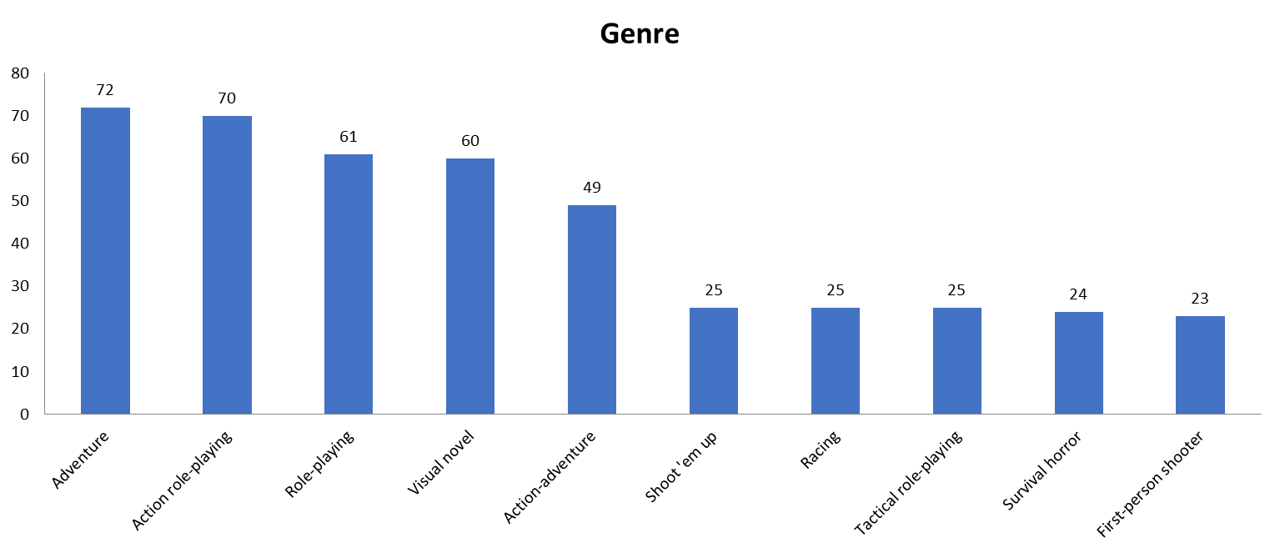
Genre (Top 10)

Slide 7
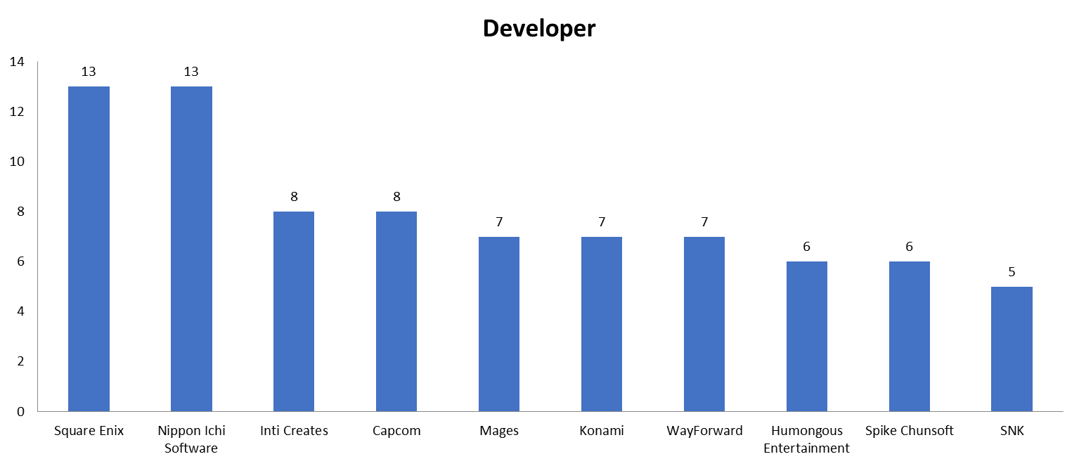
Developer (Top 10)

Slide 8
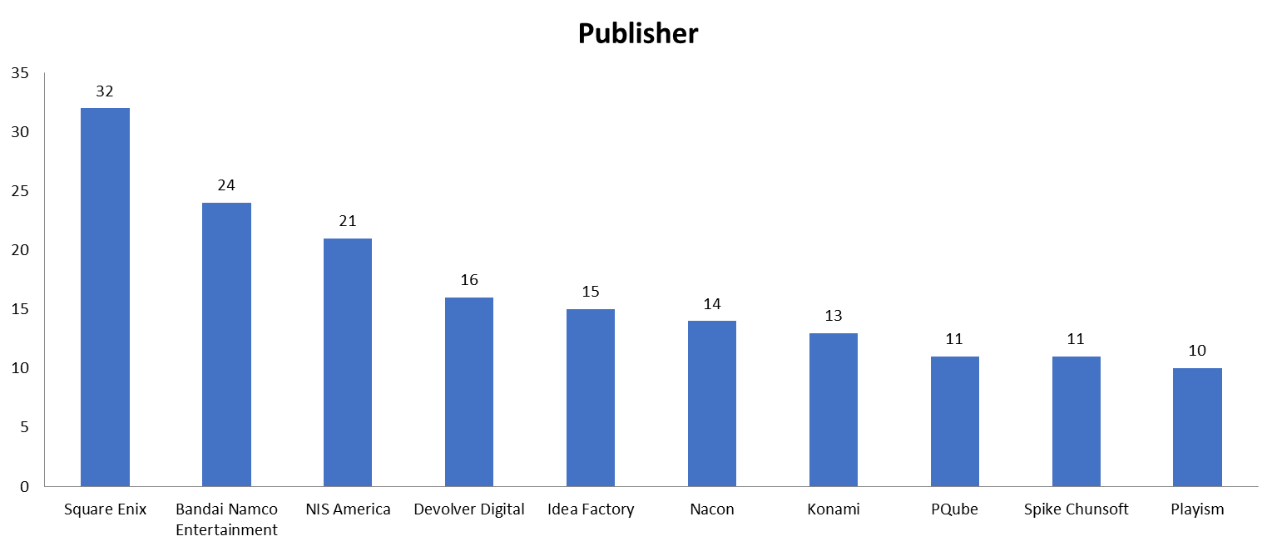
Publisher (Top 10)

Slide 9

Market Share
The data from the exploratory data analysis allows us to determine the company's market share among the different platforms, genres, and developers.
By comparing the company's market share to its competitors, we can identify areas where the company has a strong presence and areas where there is room for growth.
For example, if the company has a relatively low market share among games released on the Nintendo Switch, it could indicate an opportunity to increase market share by developing and distributing more games on that platform.
Additionally, by evaluating the company's market share in specific genres and among specific developers, we can identify areas where the company has a competitive advantage or disadvantage, which can inform our future game development and distribution strategies.

Slide 10

Opportunities
The data shows that there are opportunities for the company to increase its market share and revenue by developing and distributing more games on the Nintendo Switch, Adventure, and Action genres.
The data also indicates that there is a potential to expand the company's reach by working with Square Enix, or developers and publishers with similar popularity.
The data also indicates that the gaming industry is becoming more diverse and inclusive, with a significant increase in the number of releases from independent and smaller developers, which could be a good opportunity for the company to explore.

Slide 11

Thank you

